Slide 1


Slide 2
GROUND RULES
Work together to stay on track
Make your point and move on
Debate IDEAS, not PEOPLE
Ask questions if you have questions
Be engaged and acknowledge each others’ contributions
Share new ideas and be innovative!

Slide 3

FACILITIES
Restrooms require a key. Ladies turn left immediately and bathroom on the right. Mens are through the elevator bank and down hall to the left.
Coffee, Water, and Light Snacks available in the back of the room
Please turn Cell phones to silent and take call outside the meeting room
WiFi is available from the Guest network. Enter the password, then open a new Internet Explorer window and accept the terms.
GTRI spaces are secured. If you leave the area, knock on the glass doors to get back in
If you have any problems, call Katherine Escobar
757-434-3291

Slide 4
Welcome
Introductions
Please share
Your name
Agency/affiliation
NIEM relationship/areas of involvement (e.g., Domain, NBAC, NTAC, ESC, NMO, Emerging Technology Tiger Team, International Tiger Team, etc.)

Slide 5
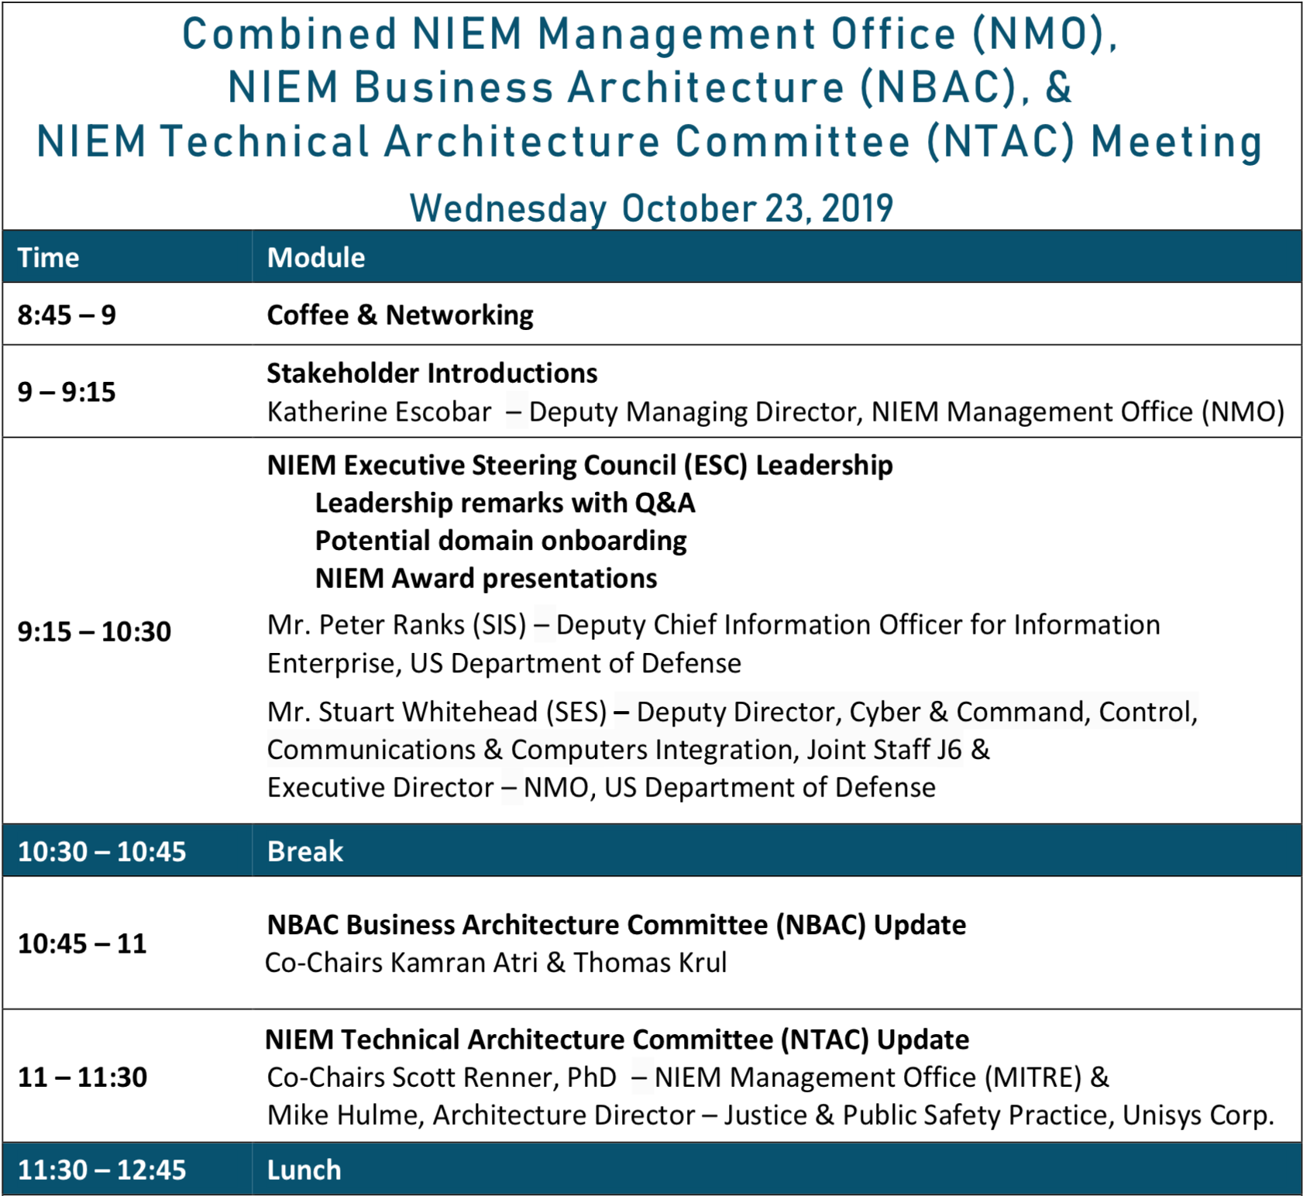

Slide 6
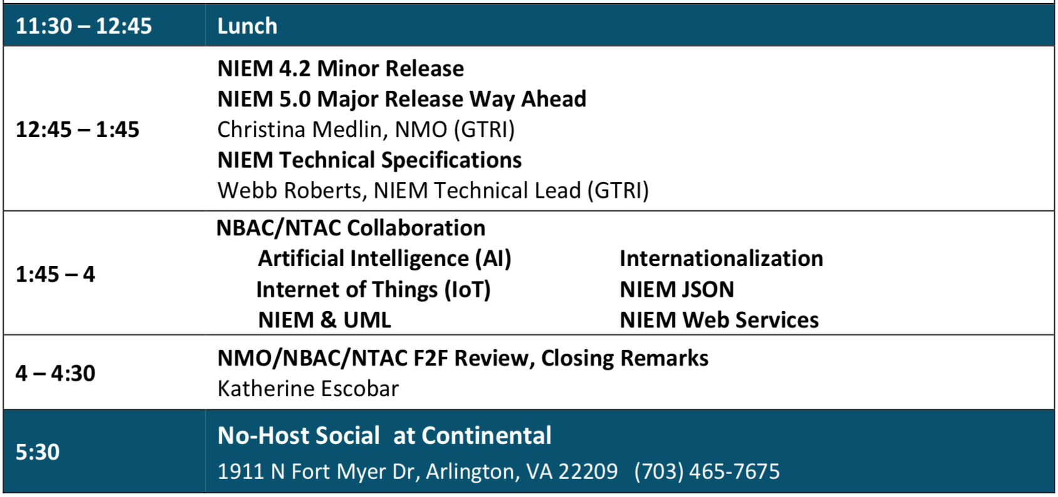

Slide 7
NIEM Executive Steering Council (ESC) Leadership
Mr. Stuart Whitehead (SES)
Deputy Director, Cyber & Command, Control, Communications & Computers Integration, Joint Staff J6 & Executive Director – NMO, US Department of Defense
Mr. Peter Ranks (SIS)
Deputy Chief Information Officer for Information Enterprise US Department of Defense

Slide 8


Slide 9


Slide 10


Slide 11


Slide 12
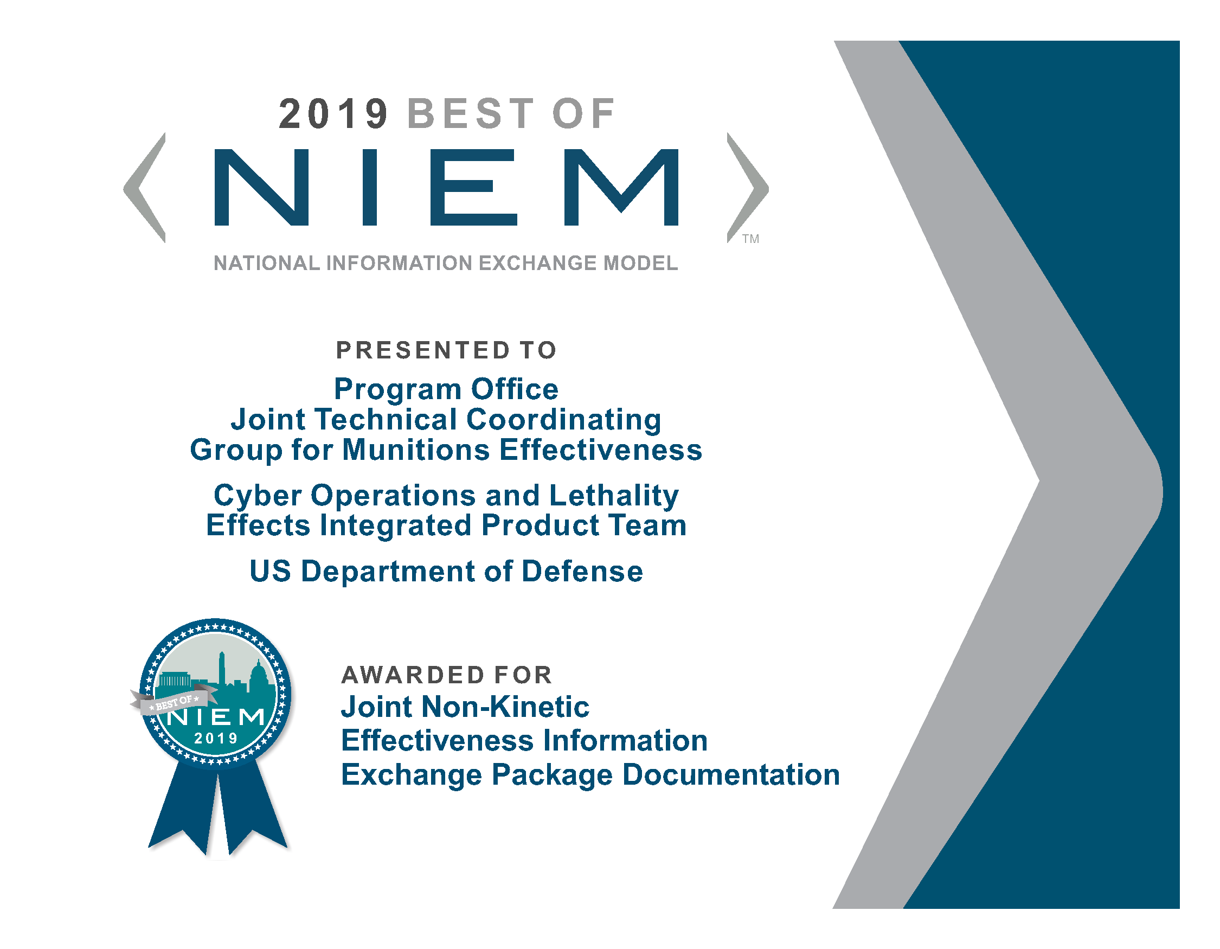

Slide 13


Slide 14


Slide 16
Welcome
Introductions
Please share
Your name
Agency/affiliation
NIEM relationship/areas of involvement (e.g., Domain, NBAC, NTAC, ESC, NMO, Emerging Technology Tiger Team, International Tiger Team, etc.)

Slide 17
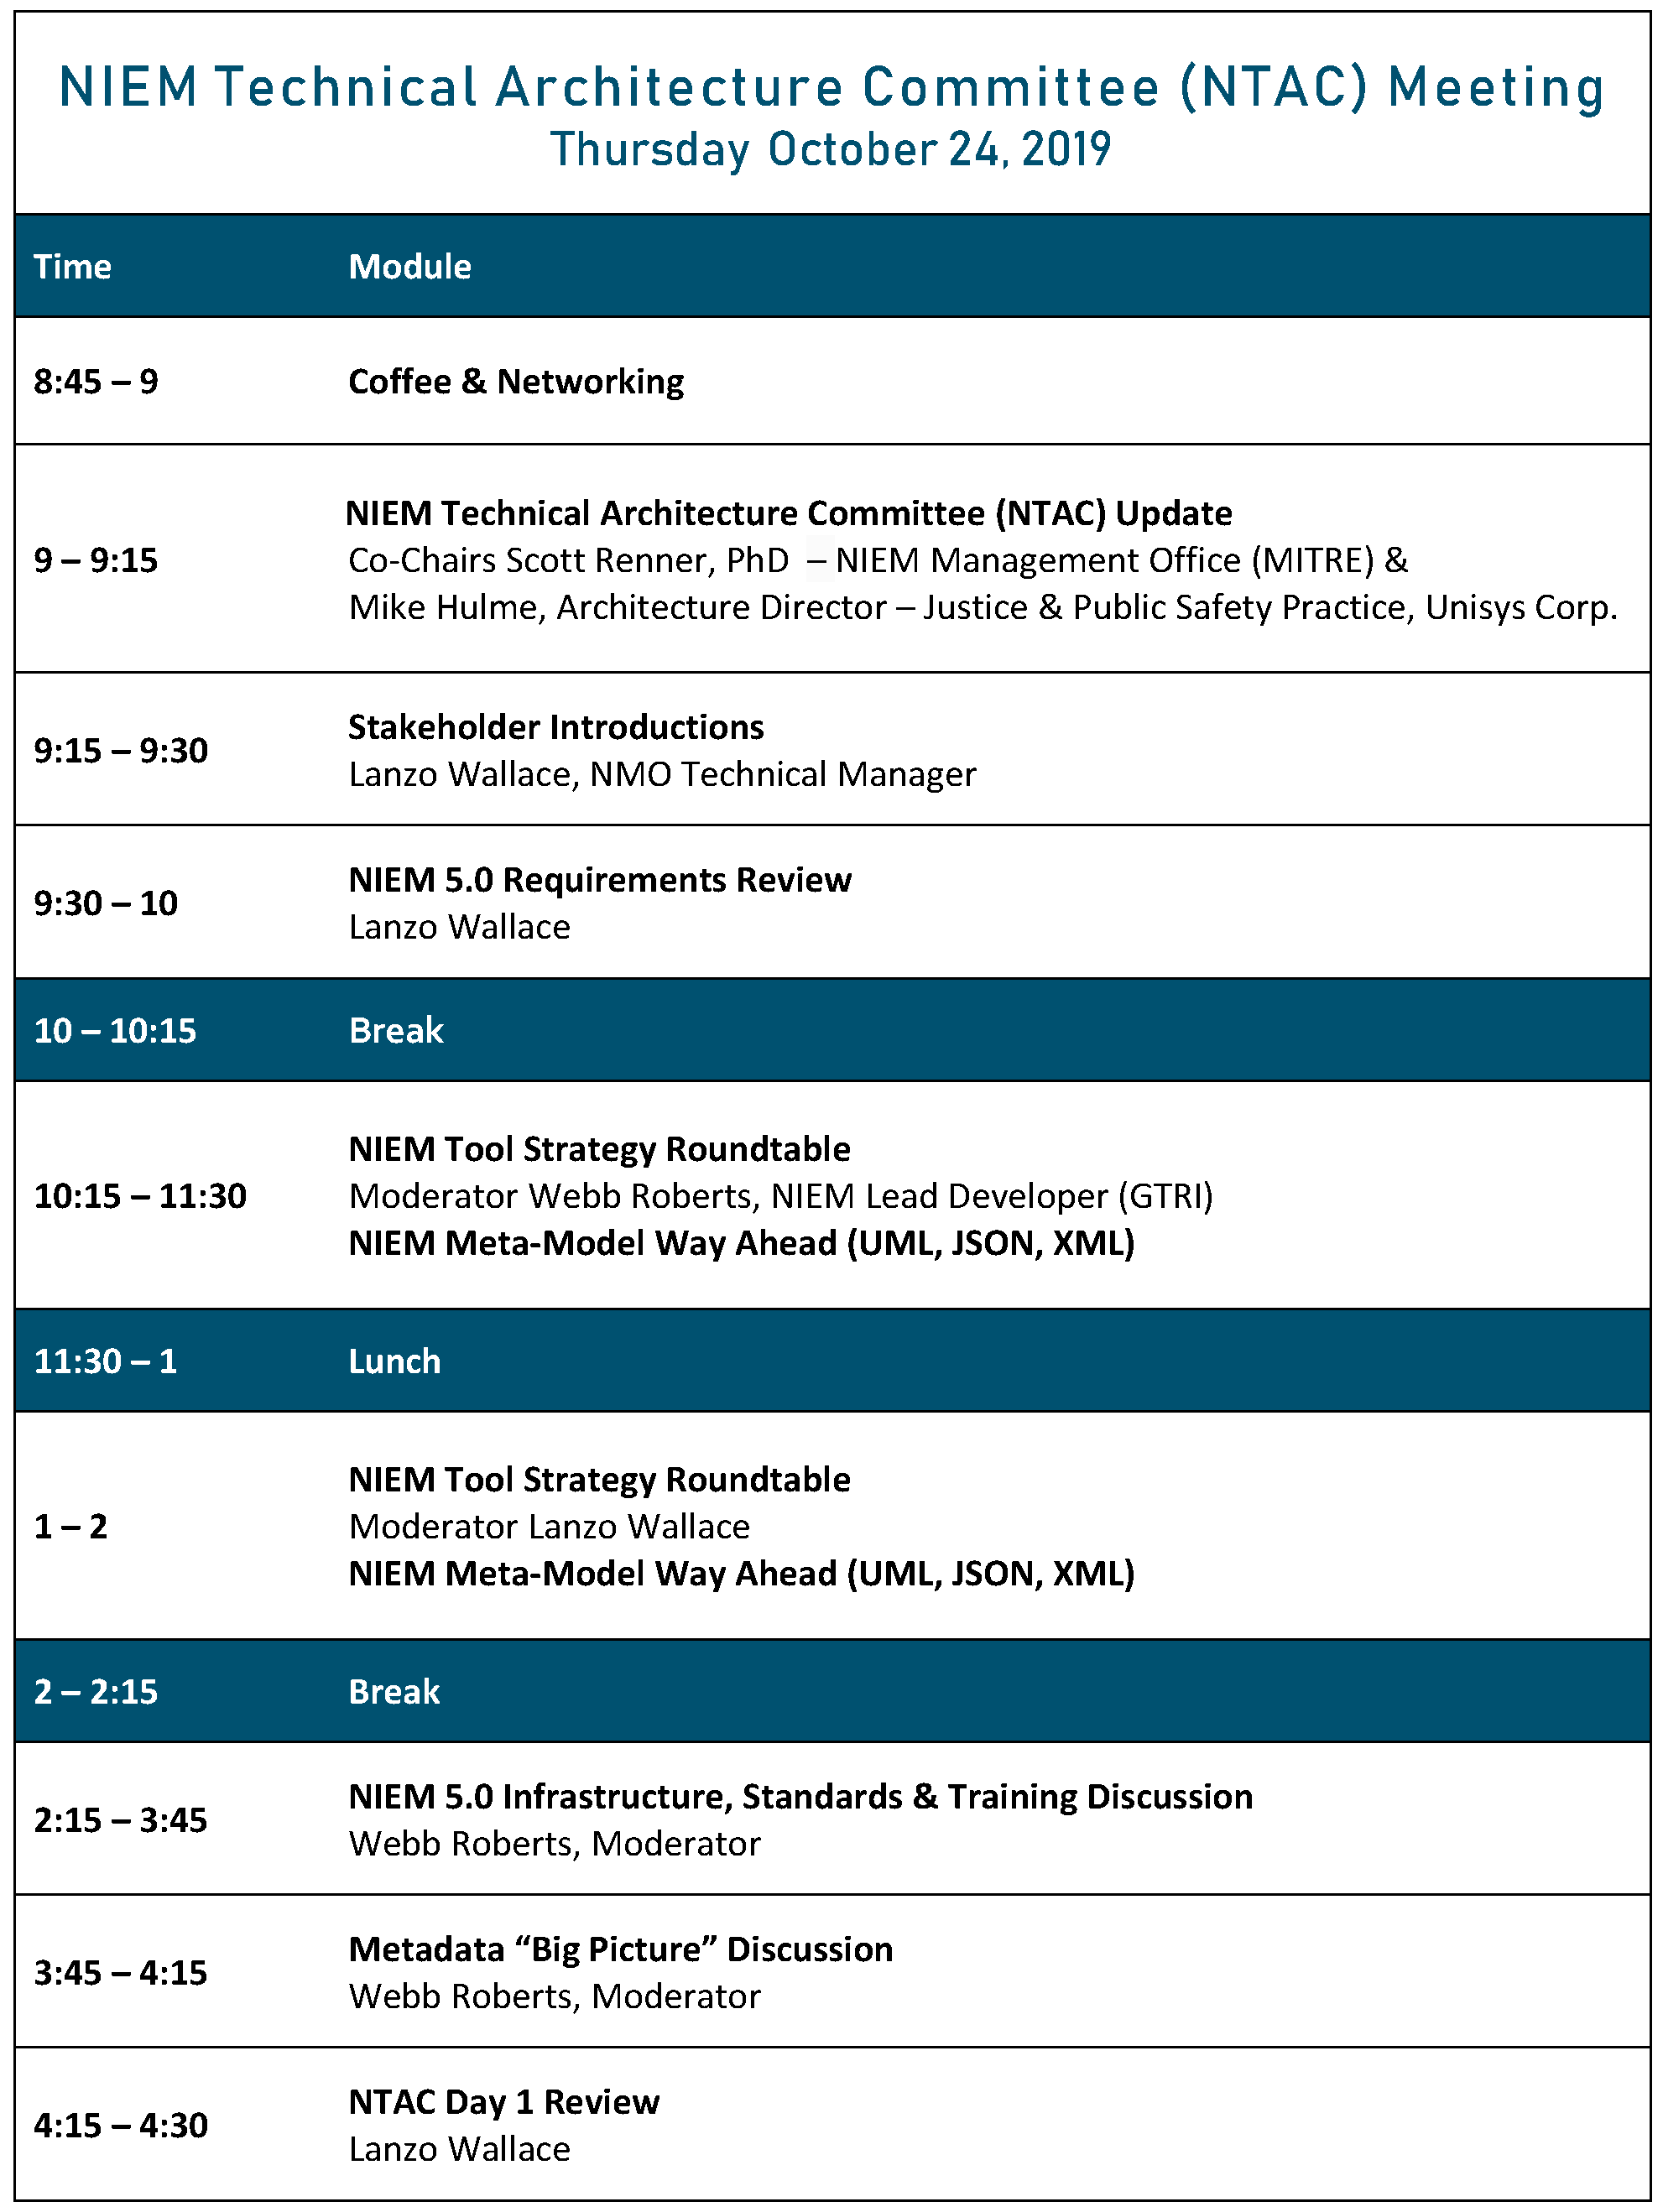

Slide 19
Welcome
Introductions
Please share
Your name
Agency/affiliation
NIEM relationship/areas of involvement (e.g., Domain, NBAC, NTAC, ESC, NMO, Emerging Technology Tiger Team, International Tiger Team, etc.)

